Slide 1
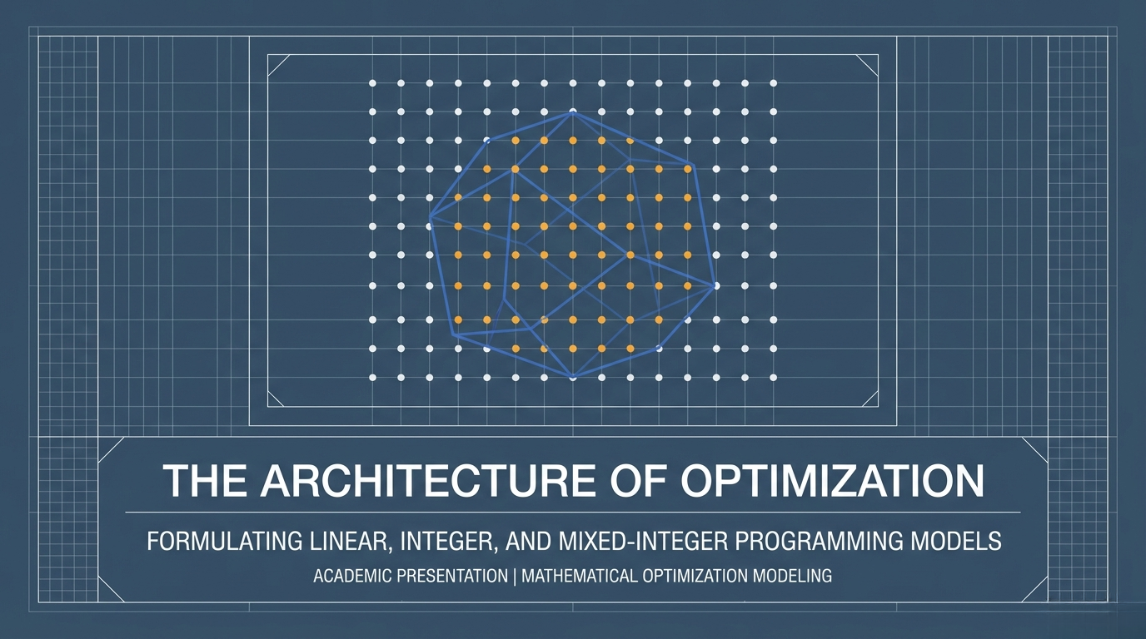

Slide 2
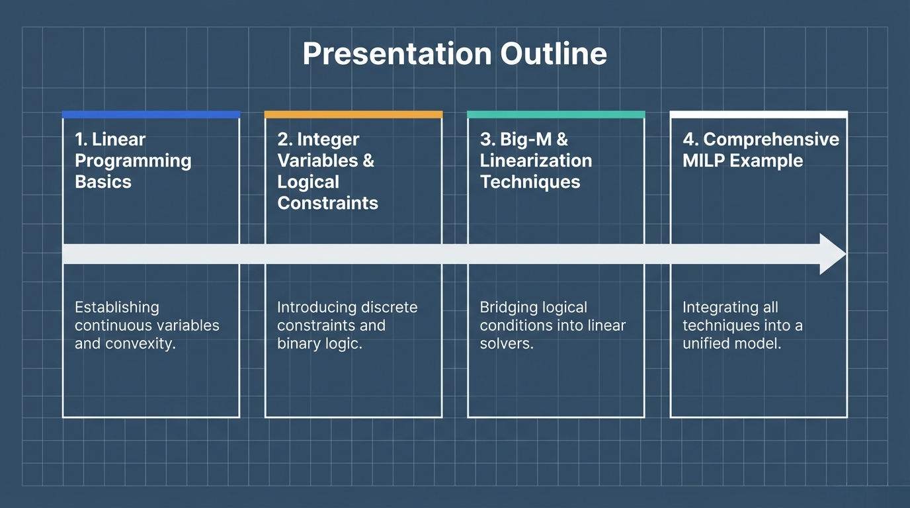
Notes:
Slide 1: Presentation Outline "Welcome to our presentation. Today, we will explore the progression from basic linear models to advanced mixed-integer frameworks. Our outline is divided into four main sections. First, we will cover Linear Programming Basics, establishing continuous variables and convexity. Second, we will introduce Integer Variables and Logical Constraints, focusing on discrete constraints and binary logic. Third, we will discuss Big-M and Linearization Techniques to bridge logical conditions into linear solvers. Finally, we will conclude with a Comprehensive MILP Example that integrates all these techniques into a unified model. Let's begin by establishing our foundational framework."

Slide 3
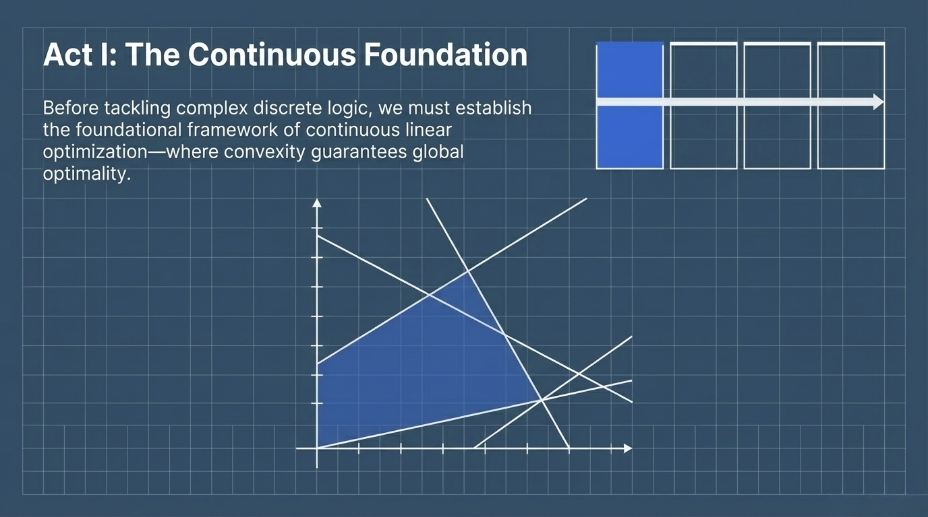
Notes:
Slide 2: Act I: The Continuous Foundation "This brings us to Act I: The Continuous Foundation. Before we can tackle complex discrete logic, we must first establish the foundational framework of continuous linear optimization. In this realm, convexity is the key property that mathematically guarantees global optimality. Let's dive deeper into the specific mathematical fundamentals that make these continuous models work."

Slide 4
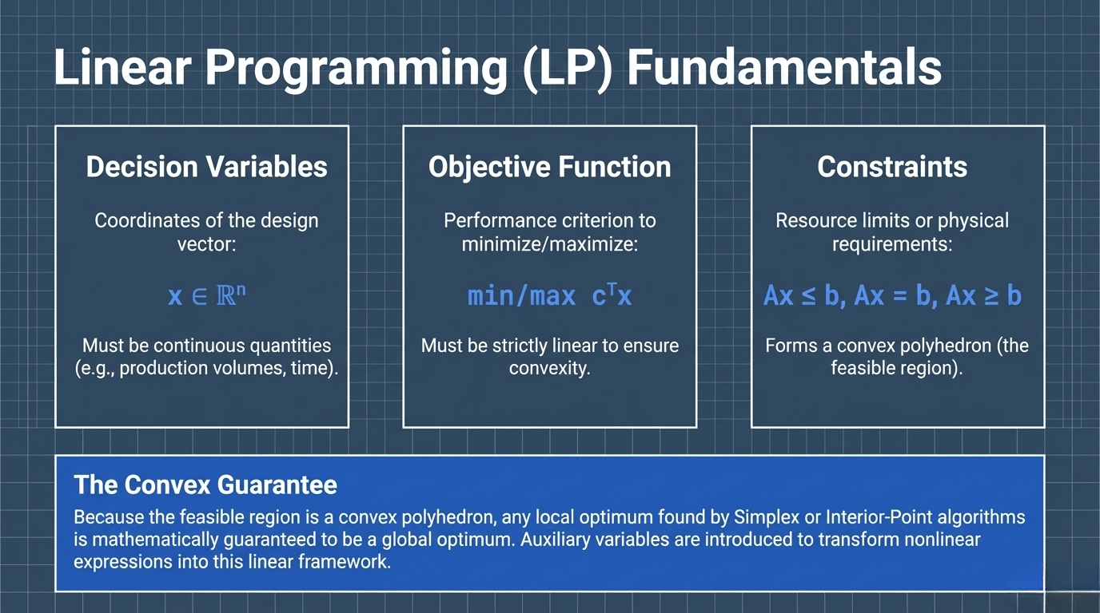
Notes:
Slide 3: Linear Programming (LP) Fundamentals "In Linear Programming Fundamentals, our model consists of three core components. First, Decision Variables represent the coordinates of the design vector and must be continuous quantities, such as production volumes or time. Second, the Objective Function is our performance criterion to minimize or maximize, and it must be strictly linear to ensure convexity. Third, our Constraints define resource limits or physical requirements, which collectively form a convex polyhedron known as the feasible region. The most critical takeaway here is 'The Convex Guarantee': because the feasible region is a convex polyhedron, any local optimum found by Simplex or Interior-Point algorithms is mathematically guaranteed to be a global optimum. However, real-world problems aren't always continuous."

Slide 5
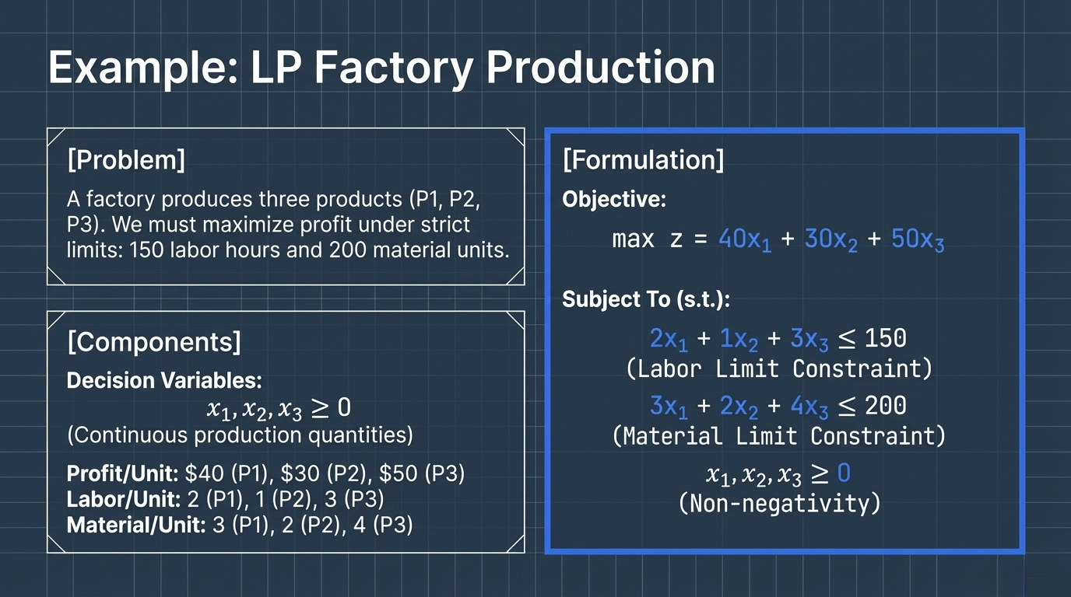

Slide 6
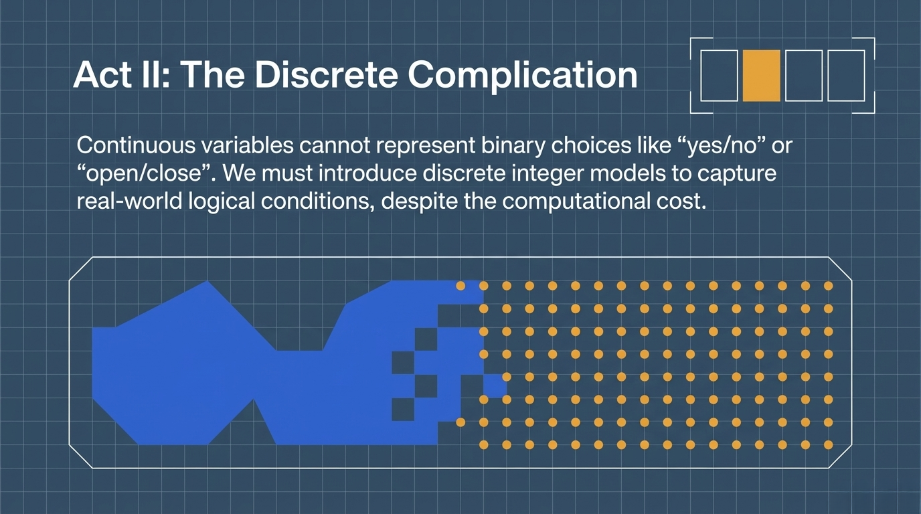
Notes:
Slide 4: Act II: The Discrete Complication "This leads us to Act II: The Discrete Complication. In many practical scenarios, continuous variables simply cannot represent binary choices like 'yes/no' or 'open/close'. To capture these real-world logical conditions, we must introduce discrete integer models, even though they come with a significantly higher computational cost. Let's compare this discrete approach directly with our continuous foundation."

Slide 7
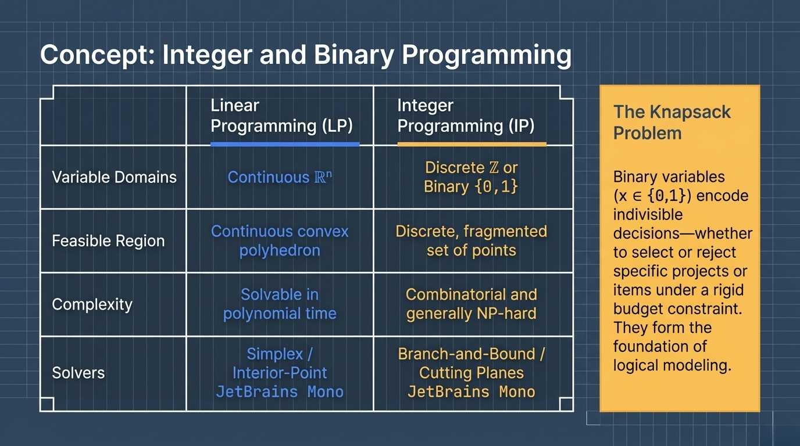
Notes:
Slide 5: Concept: Integer and Binary Programming "Here we contrast Linear Programming with Integer Programming. While LP uses continuous domains and a convex feasible region solvable in polynomial time, IP restricts variables to discrete or binary values. This fragments the feasible region into a discrete, disconnected set of points, making the problem combinatorial and generally NP-hard, which requires advanced solvers like Branch-and-Bound or Cutting Planes. A classic example is the Knapsack Problem, where binary variables encode indivisible decisions—whether to select or reject specific items under a rigid budget constraint. But how do we combine both continuous and discrete elements in a single model?"

Slide 8
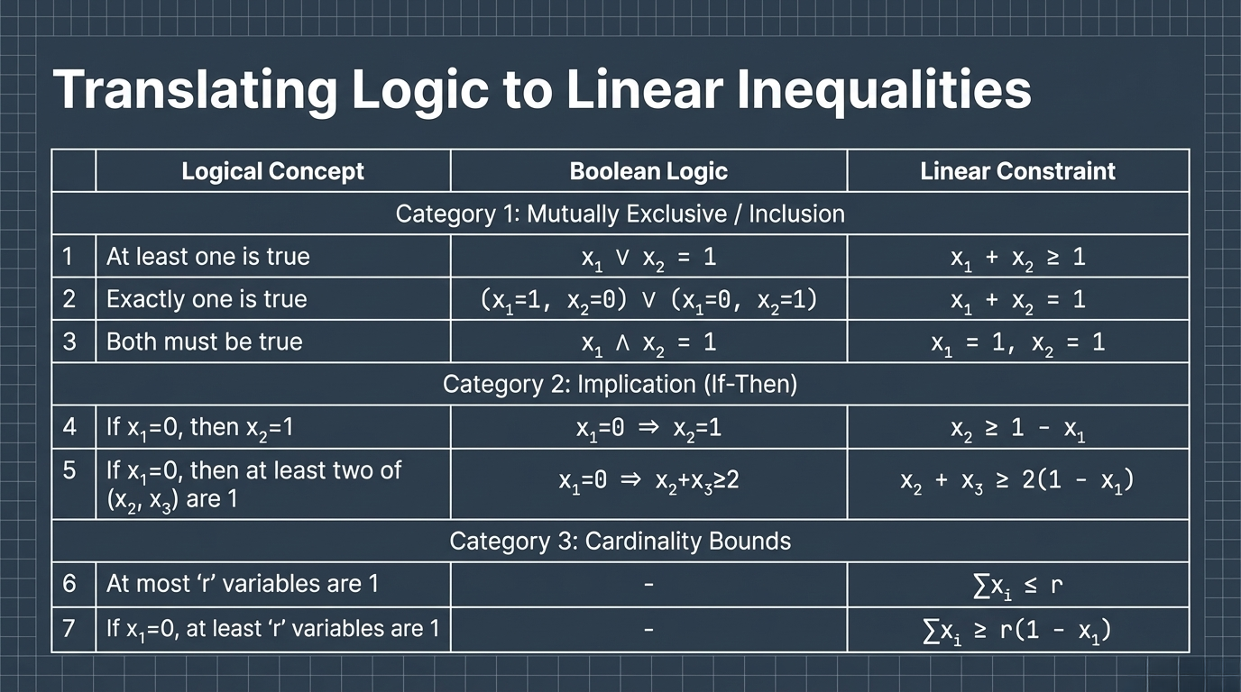

Slide 9
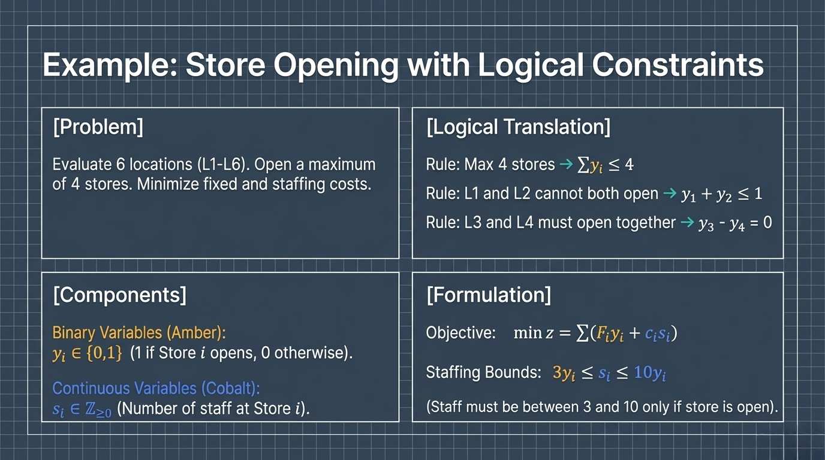

Slide 10
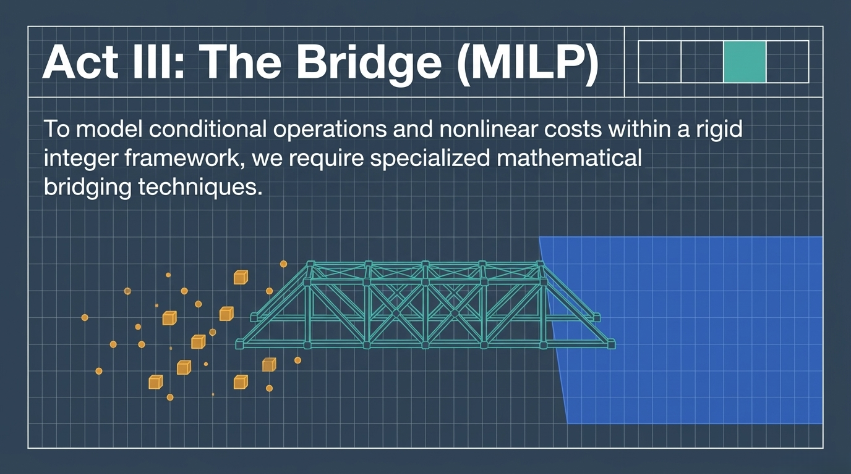
Notes:
Slide 6: Act III: The Bridge (MILP) "We do this in Act III: The Bridge, utilizing Mixed-Integer Linear Programming, or MILP. To successfully model conditional operations and nonlinear costs within a rigid framework alongside continuous variables, we require specialized mathematical bridging techniques. The most prominent and powerful of these techniques is the integer Big-M method.“ it is like x is continoius and y is integer

Slide 11
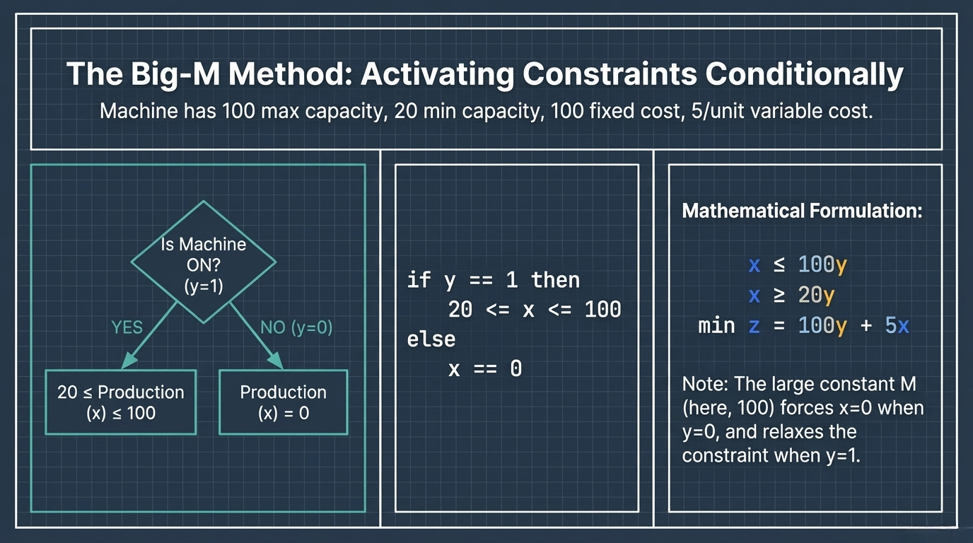
Notes:
Slide 7: The Big-M Method: Activating Constraints Conditionally "The Big-M Method allows us to activate constraints conditionally. Consider a machine with a minimum capacity of 20, a maximum of 100, and a fixed setup cost. We introduce a binary variable 'y' to represent if the machine is ON (y=1) or OFF (y=0). Mathematically, we formulate this using a large constant 'M'—in this case, 100. By setting our constraints as x≤100y and x≥20y, the Big-M seamlessly forces continuous production 'x' to zero when the machine is OFF, and relaxes the constraint when the machine is ON. This also allows us to accurately model the fixed cost in our objective function. Besides activation, we also need techniques to handle non-linear functions.“ it make condition for the constraints

Slide 12
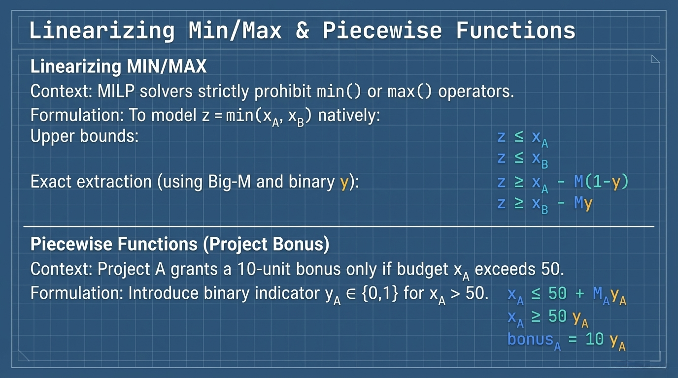
Notes:
Slide 8: Linearizing Min/Max & Piecewise Functions "MILP solvers strictly prohibit non-linear operators like minimum or maximum, so we must linearize them natively. For example, to model z=min(xA​,xB​), we define upper bounds and use exact extraction with Big-M and a binary indicator variable 'y'. Similarly, for piecewise functions—like a project granting a 10-unit bonus only if a budget exceeds 50—we can introduce a binary indicator variable that mathematically triggers the bonus when the condition is met. Having covered these advanced bridging techniques, we can now build our final, unified model."

Slide 13
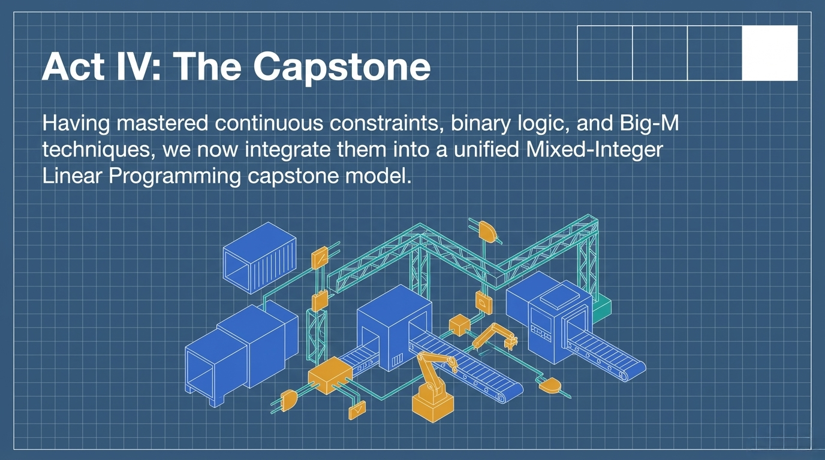
Notes:
Slide 9: Act IV: The Capstone "This brings us to Act IV: The Capstone. Having mastered continuous constraints, binary logic, and Big-M techniques, we are now ready to integrate them all into a unified Mixed-Integer Linear Programming capstone model. Let's look at a comprehensive manufacturing scenario."

Slide 14
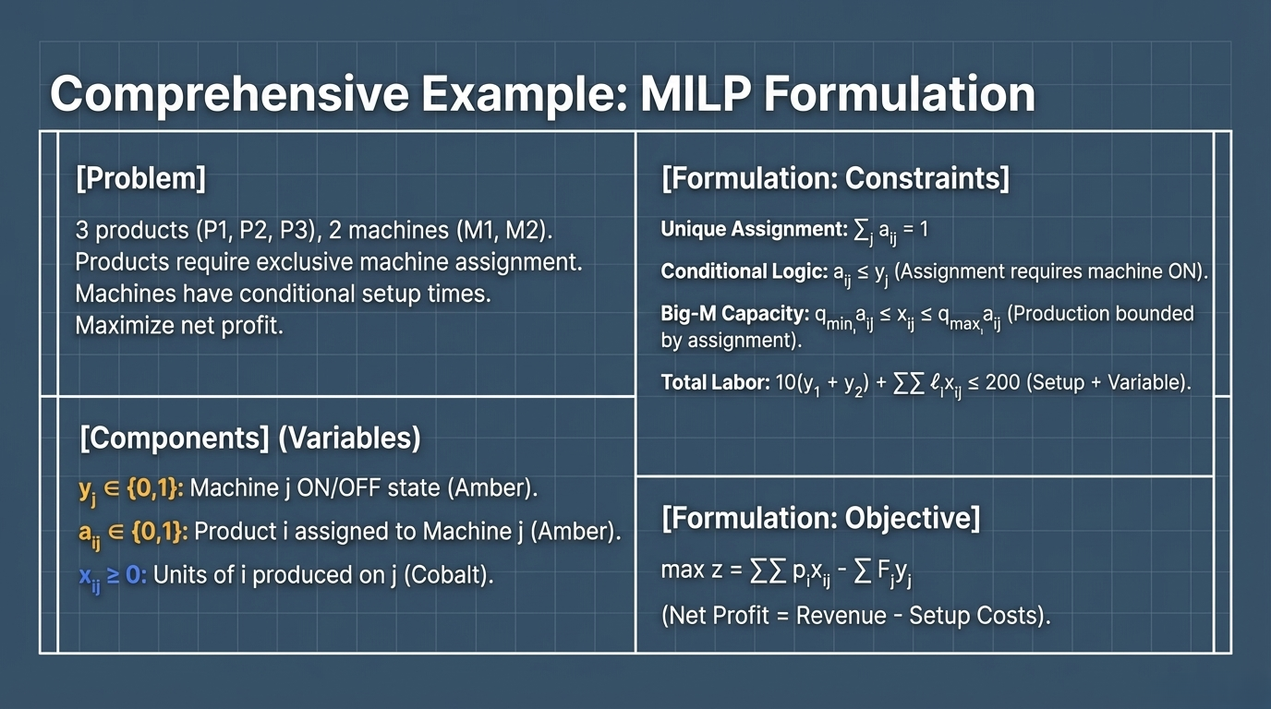
Notes:
Slide 10: Comprehensive Example: MILP Formulation "In our comprehensive example, we have 3 products requiring exclusive assignment across 2 machines with conditional setup times, and our goal is to maximize net profit. We define binary variables 'y' for the machine ON/OFF state, binary variables 'a' for product assignment, and continuous variables 'x' for units produced. Our constraints mathematically enforce unique assignment, conditional logic where assignment requires a machine to be ON, Big-M capacity limits bounded by assignment, and total labor bounds. Finally, our objective seamlessly subtracts the setup costs from the net revenue. This unified model brings all our logical and continuous concepts together."

Slide 15
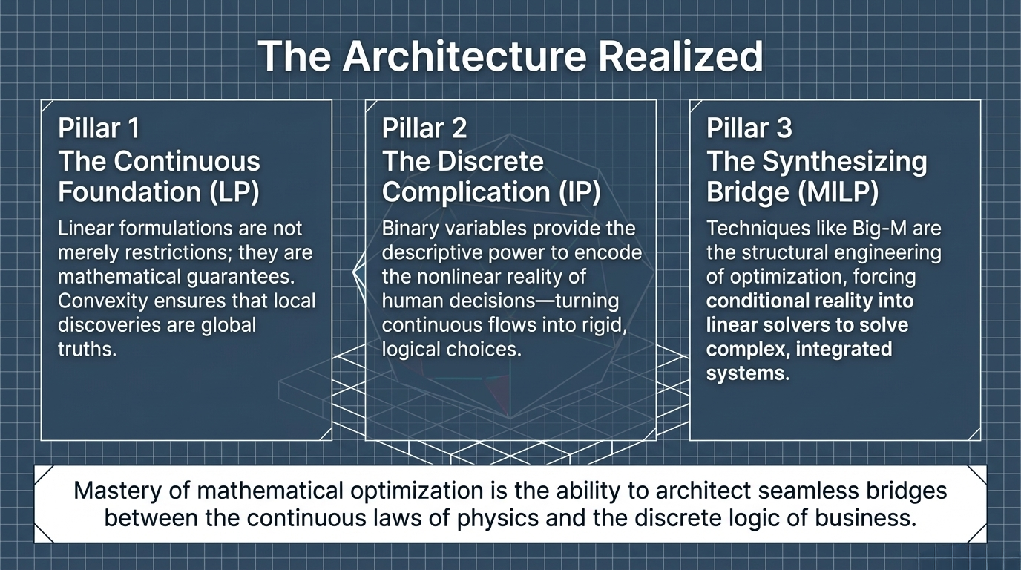
Notes:
Slide 11: The Architecture Realized "To conclude, our modeling architecture is realized through three pillars. Pillar 1 is the Continuous Foundation of LP, where mathematical convexity ensures that local discoveries are global truths. Pillar 2 is the Discrete Complication of IP, where binary variables provide the descriptive power to encode the nonlinear reality of human decisions. Pillar 3 is the Synthesizing Bridge of MILP, using structural techniques like Big-M to force conditional reality into linear solvers. Ultimately, the mastery of mathematical optimization is the ability to architect seamless bridges between the continuous laws of physics and the discrete logic of business. Thank you."

